Slide 1
5 Steps
Business Concept / Mission Statement
Get Inspired
Sketch Sketch Sketch
Digital Sketch
Refine & Variations

Slide 2
FollowAndrew
1) Get the business idea / mission / name
Tech
Education
Tutorials

Slide 3
Tips
Logo should reflect the nature of the business if possible
Should scale
Simple shapes / lines
Should ‘work’ in monotone & black/white versions
Avoid Cliche
If using typography, make it custom

Slide 4
FollowAndrew
2) Get Inspired
http://logospire.com
https://www.designspiration.net/search/saves/?q=logo
http://dribble.com

Slide 5
FollowAndrew
3) Sketch Sketch Sketch
Use dot paper
https://www.amazon.com/Rhodia-Black-Dot-Pad-12-5/dp/B005IAZXUO
Print your own dot paper
https://paperkit.net/dottedpaper

Slide 6
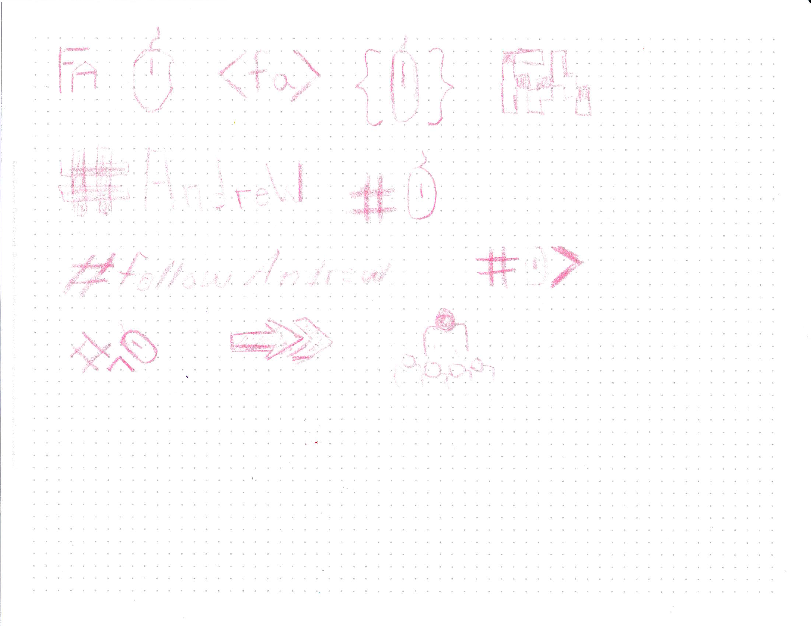
Sketches

Slide 7
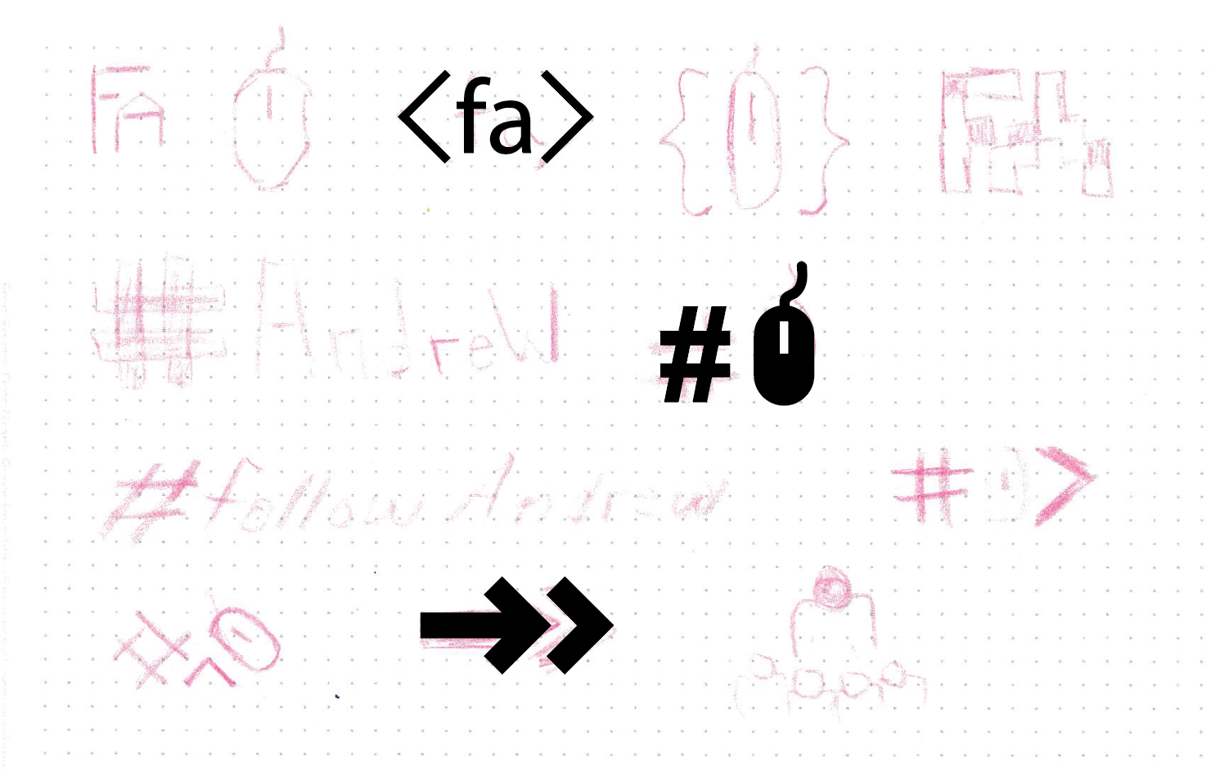
FollowAndrew
4) Digital Sketch

Slide 8

FollowAndrew
5) Refine & Variations

